Slide 1

Cycloid Reducer
周奕彬

Slide 2
大綱
不同種減速機形式
等效連桿-曲率半徑
未來目標

Slide 3
四種Cycloid Reducer
Stationary ring gear type epicycloid reducer
Rotating ring gear type epicycloid reducer
Stationary ring gear type hypocycloid reducer
Rotating ring gear type hypocycloid reducer

Slide 4

Stationary ring gear type epicycloid reducer

Slide 5
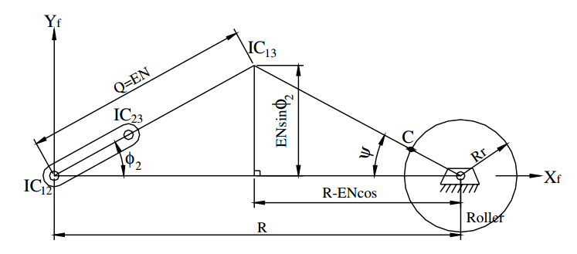
Stationary ring gear type epicycloid reducer

Slide 6

Rotating ring gear type epicycloid reducer

Slide 7
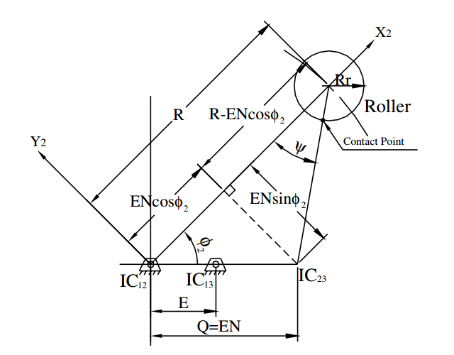
Rotating ring gear type epicycloid reducer

Slide 8
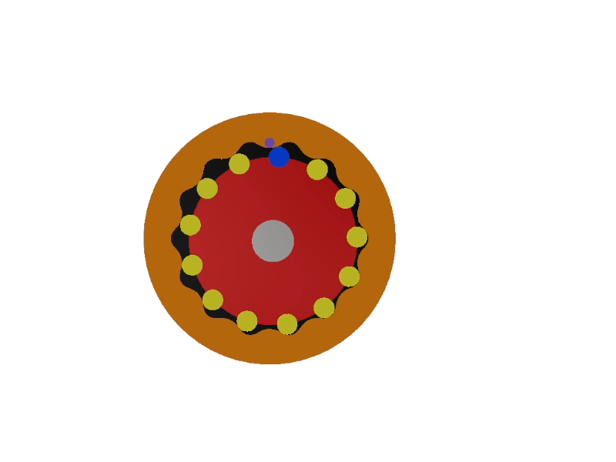
Stationary ring gear type hypocycloid reducer

Slide 9
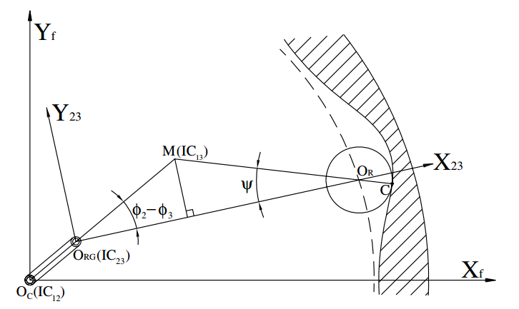
Stationary ring gear type hypocycloid reducer

Slide 10
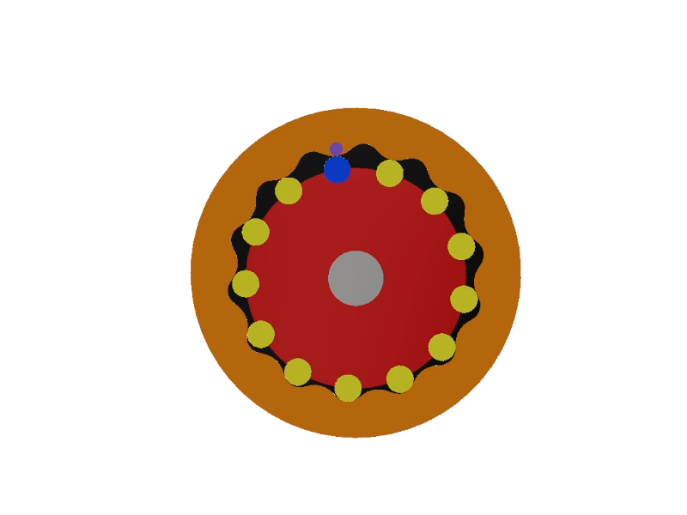
Rotating ring gear type hypocycloid reducer

Slide 11
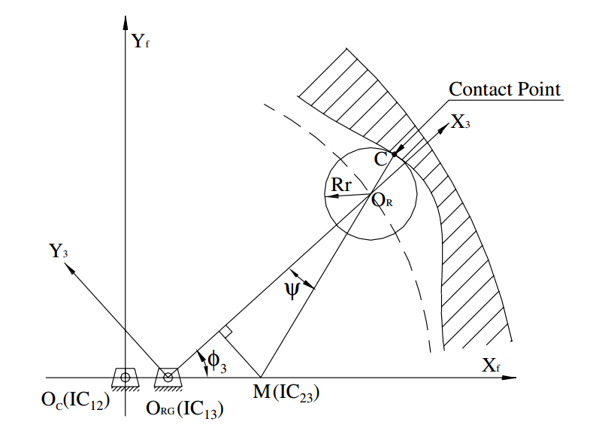
Rotating ring gear type hypocycloid reducer

Slide 12
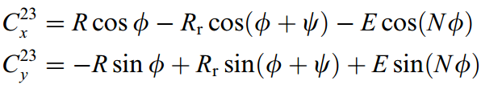
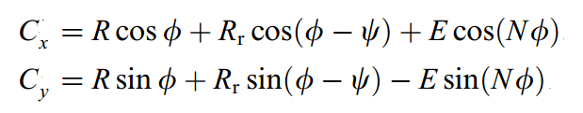
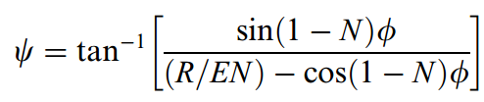
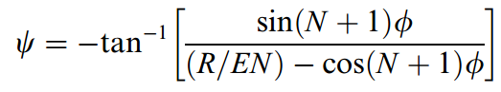
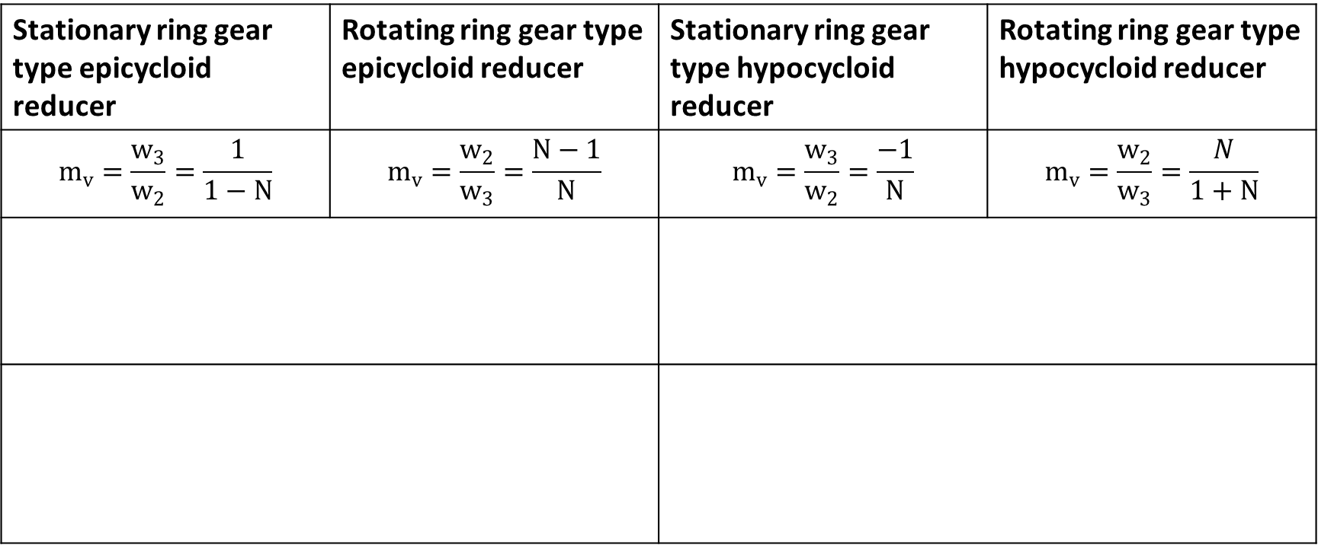
Stationary ring gear type epicycloid reducer | Rotating ring gear type epicycloid reducer | Stationary ring gear type hypocycloid reducer | Rotating ring gear type hypocycloid reducer
$$m_{v}=\frac{w_{3}}{w_{2}}=\frac{1}{1−N}$$ | $$m_{v}=\frac{w_{2}}{w_{3}}=\frac{N−1}{N}$$ | $$m_{v}=\frac{w_{3}}{w_{2}}=\frac{−1}{N}$$ | $$m_{v}=\frac{w_{2}}{w_{3}}=\frac{N}{1+N}$$

Slide 13
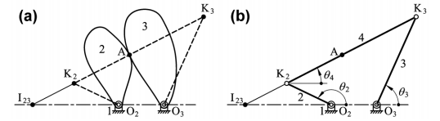
等效連桿-滑動對

Slide 14
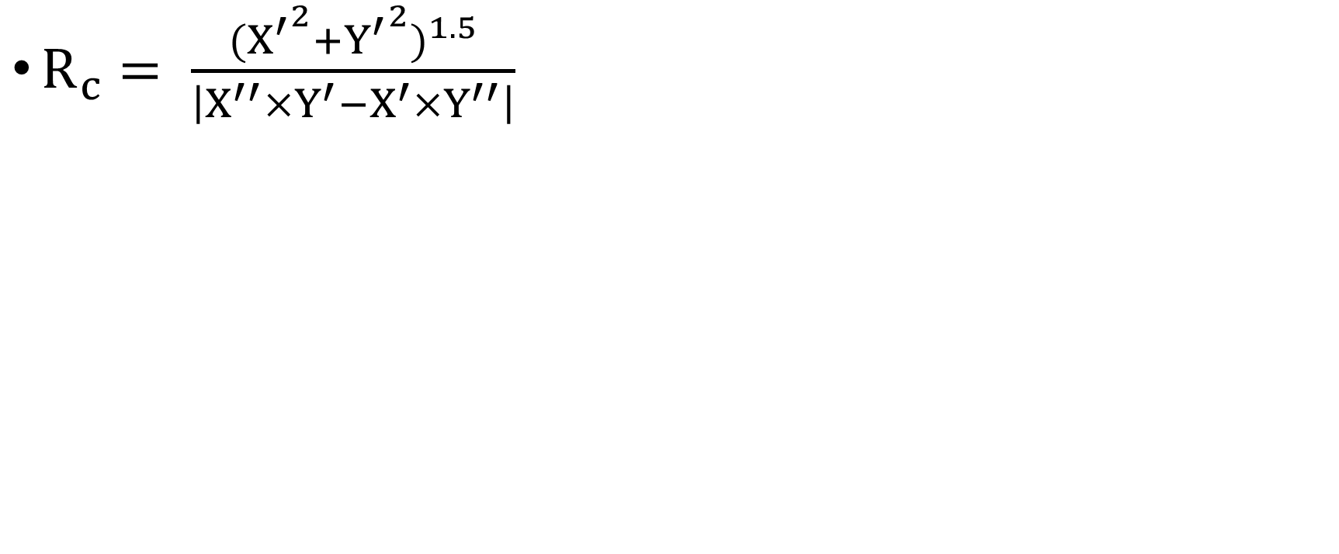
曲率半徑
$R_{c}= \frac{{{{(X}^{′}}^{2}+{Y^{′}}^{2})}^{1.5}}{\left|X^{′′}×Y^{′}−X^{′}×Y^{′′}\right|}$

Slide 15
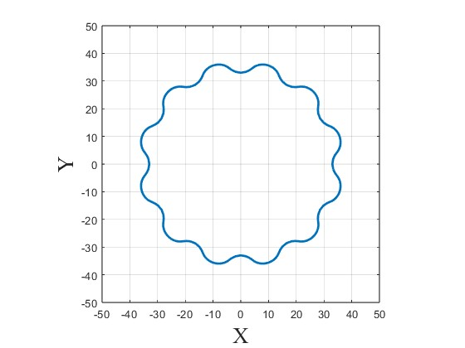
曲率半徑
N = 13
Rr = 5
R = 40
E =2

Slide 17
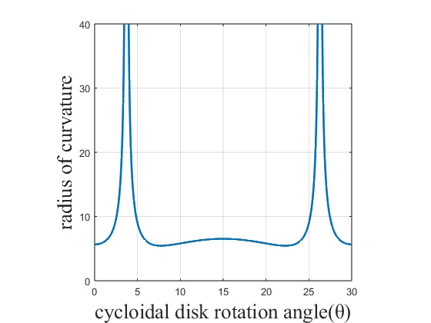
曲率半徑
N = 13
Rr = 5
R = 40
E =2

Slide 18
未來目標
尋找在曲率半徑極大下的解決辦法
以等效連桿組分析機械誤差

